Slide 1

CDBG Application Process – City Agencies
December 19, 2024
© Created by Baltimore City Department of Housing & Community Development

Slide 2
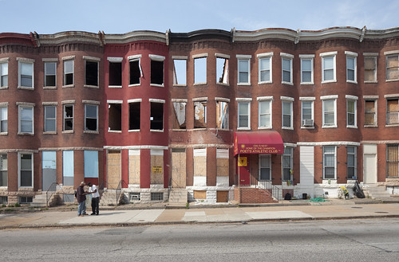
The CDBG Program
CDBG is a federally-funded program, designed to assist local jurisdictions implement community develop initiatives that address the core goals of Title I of the Housing and Community Development Act of 1974 as amended.
These goals are to develop viable communities by providing:
Decent housing
A suitable living environment
Expanding economic opportunities

Slide 3

CDBG National Objectives
In order to qualify for CDBG funding, each activity must be eligible and address one of the following national objectives as established by the Act:
Provide benefit to low- and moderate-income persons or
Aid in the prevention of elimination of slums and blight or
Address an urgent need (such as earthquakes, floods, severe hurricanes)

Slide 4
Eligible Activities
Activities that are eligible for CDBG funding include:
Acquisition, relocation and demolition of real property
Rehabilitation of residential and non-residential structures
Construction of public facilities and improvements such as water and sewer facilities, streets, neighborhood centers, and the conversion of school buildings
Public services (within certain limits)
Activities relating to energy conservation and renewable energy resources
Provision of assistance to profit-motivated businesses to carry out economic development and job creation/retention activities

Slide 5
Eligible Activities
Ineligible activities include:
Fundraising
Political activities
Expenses required to carry out the regular responsibilities of local government
Income payments
Construction/rehabilitation of buildings or portions thereof used for general conduct of government
Purchase of equipment, fixtures, motor vehicles, furnishings or other personal property

Slide 6

Unallowable Costs
Costs that are unallowable under the CDBG program include:
Bad debts
Contributions
Entertainment costs
Fines and penalties
Fundraising
Losses on other awards
Contingencies
Donations
Gifts and awards
Interest
Litigation expenses

Slide 7
Limits on the Use of Funds
Attention should be paid to the following limits on the use of CDBG funds:
Separate applications must be completed for operating support and capital projects
Funding requests to acquire property for an eligible use must identify site, sales price, and estimated value based on comparable market values
Capital cost must be supported by cost estimates
If funds are awarded for construction projects, a small percentage of the grant will be retained for City inspection and monitoring costs

Slide 8
Mayoral Priorities
Applicants should indicate how their programs or activities would meet a Mayoral Pillar and one of the objectives outlined in the City of Baltimore five-year consolidated plan (2020 – 2025).
Mayoral pillars include:
Building public safety
Prioritizing youth
Clean and healthy communities
Equitable neighborhood development
Responsible stewardship of city resources

Slide 9
Timeline for CD51
Date | Activity
Dec. 2, 2024 | Needs/performance public hearing
Jan. 17, 2025 | Deadline for submission of applications
Jan/Feb | Review awards and finalize propose budget
Jan/April | Prepare the draft Annual Action Plan for public review and comments
April/May | Public hearing on draft Annual Action Plan
May 10, 2025 | Deadline for written comments on draft Annual Action Plan Review of all public comments Finalize Annual Action Plan and submit to City's Board of Estimates for approval
May 17, 2025 | Submit Annual Action Plan to HUD
June/July | HUD approves Annual Action Plan
July 1, 2025 | Program year begins

Slide 10
Guidelines for Submission
All applications must be completed in Neighborly
Operating and Capital applications must be separated
Failure to provide all required information could result in denial of the application
All applications must be submitted in Neighborly by January 17, 2025
Note the following:
CDBG funds are limited so it is important that applications identify other resources available to assist with the program/project
Continued funding is not guaranteed
HUD Allocations are expected to remain flat or be reduced in CFY 2026
Budget must be complete and accurate. Incomplete and inaccurate budgets will not be scored or funded. Changes to a budget after the application is submitted will not be allowed.

Slide 11
Demonstration
of Neighborly CD-51 Application
https://portal.neighborlysoftware.com/baltimoremd/Participant
Link to new application available on DHCD website – Plans & Reports page.
www.baltimorecity.gov\m\plans-reports

